Slide 1
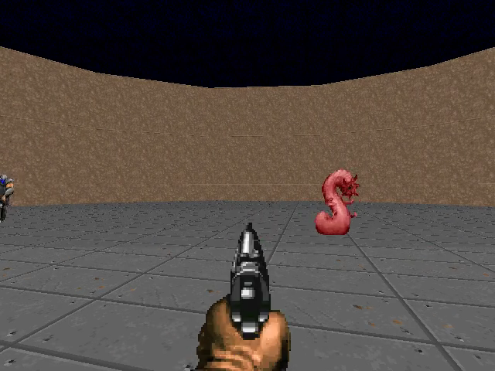
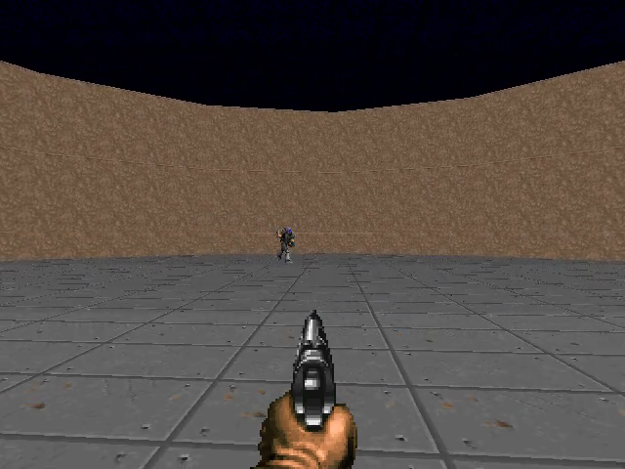
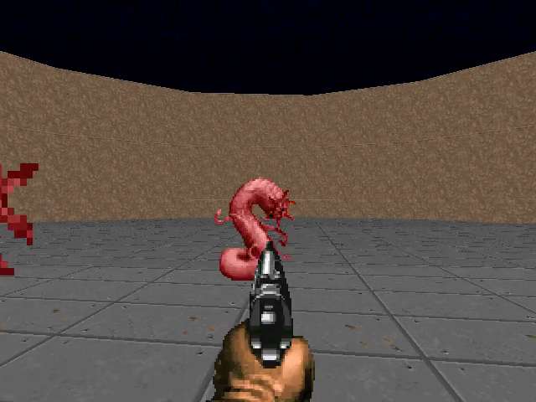
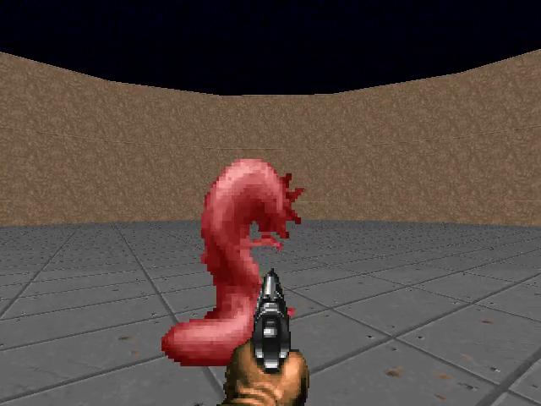
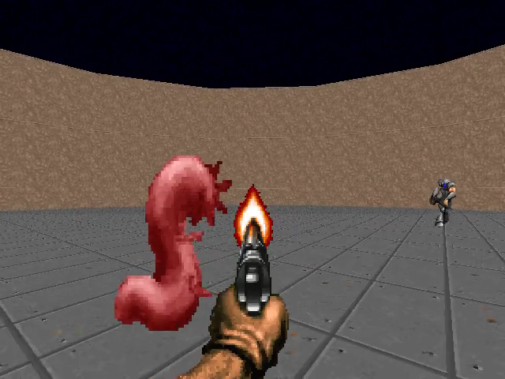
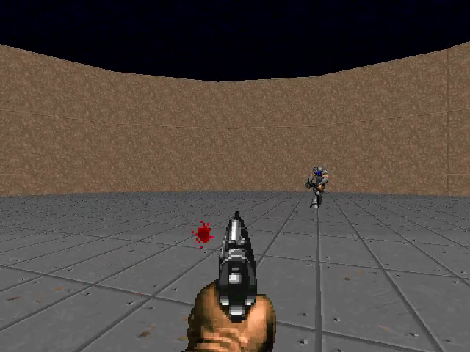
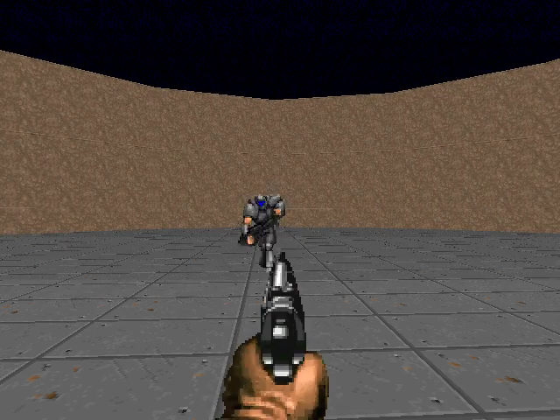
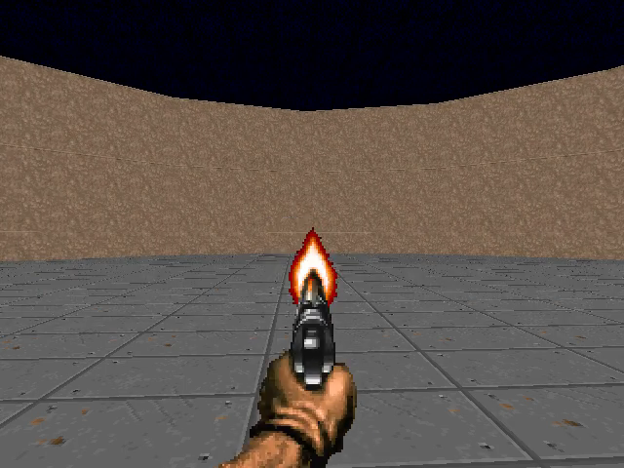
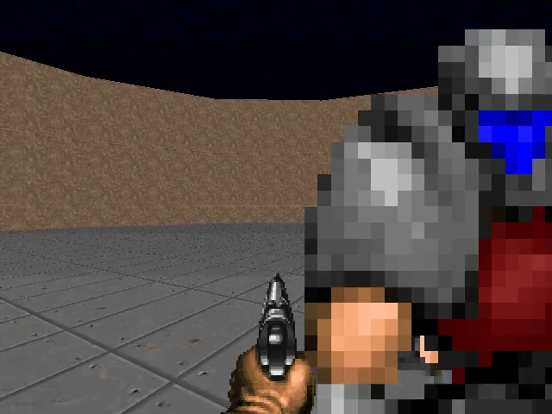
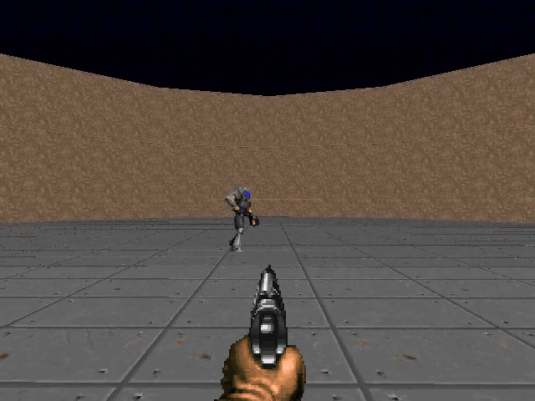
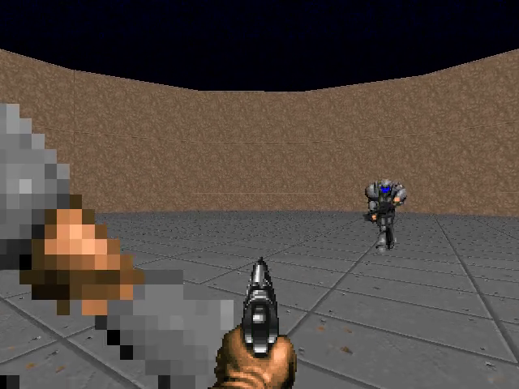
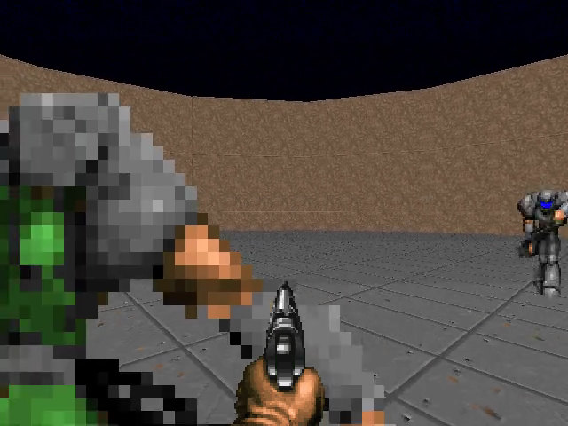
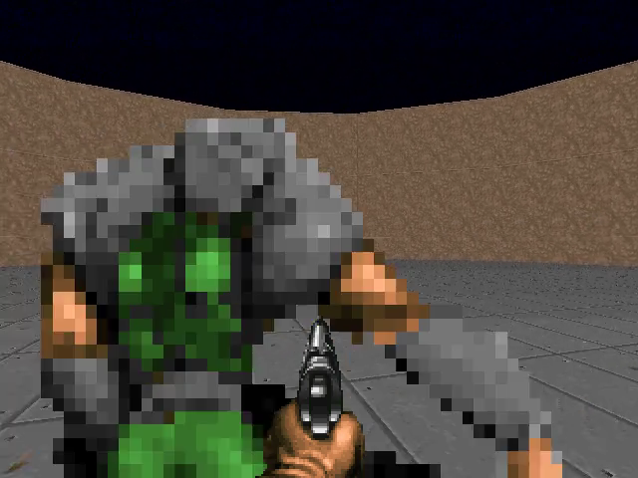
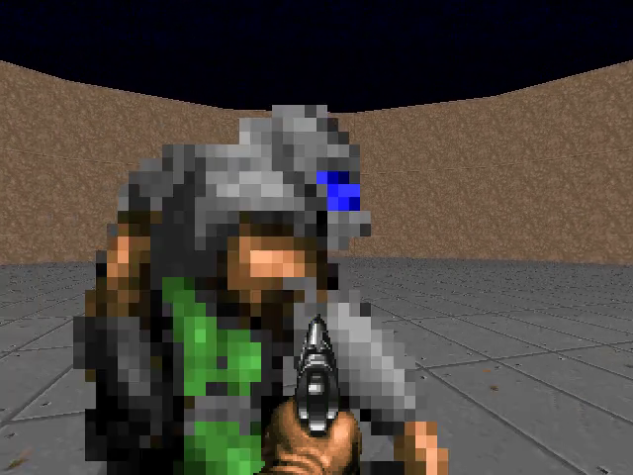
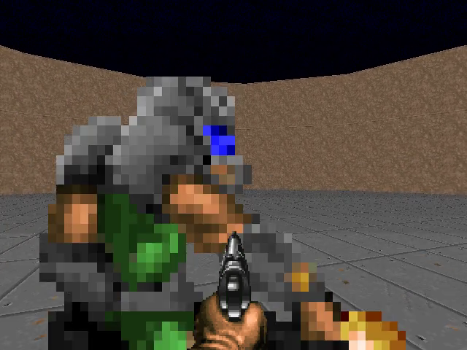
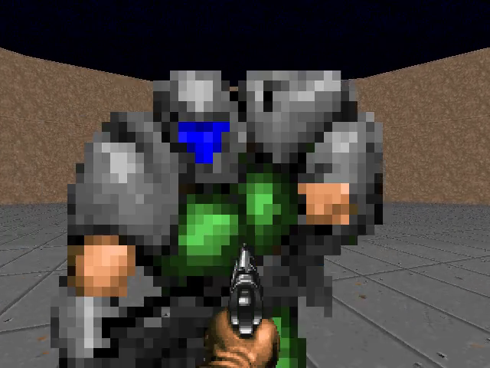
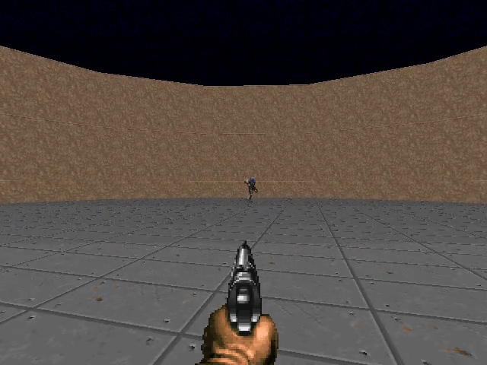
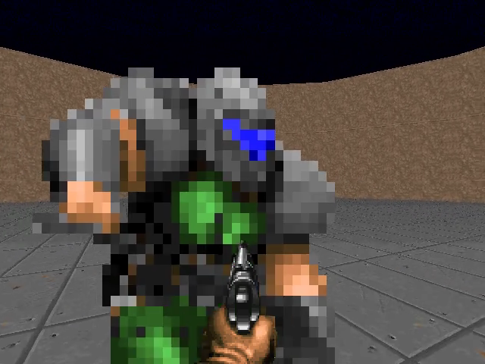
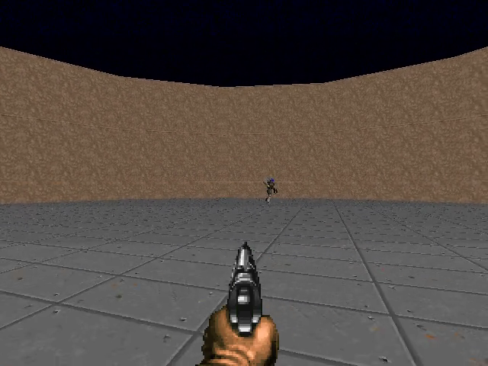
1
Agent 1 (main)
Agent 2 (camera)
Map
1
2
3
4
5
6
7
8
+1
Agent 1 (main)
+1
Agent 2 (camera)
+1
Map
+1

Slide 2
1
Agent 1 (main)
Agent 2 (camera)
Map
+1
+1
1
2
3
4
5
6
7
8
Agent 1 (main)
Agent 2 (camera)
Map
+1
+1

Slide 3
1
Agent 1 (main)
Agent 2 (camera)
Map
+1
1
Enemies
2
3
4
5
6
7
8
Map
Agent 1
+1
+1
Agent 2
Agent 1 (main player)
+1
+1
Agent 2 (cameraman)

Slide 6
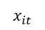
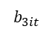
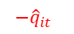
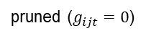
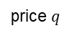
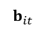
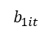
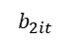
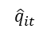
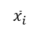
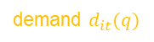
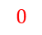
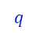
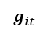
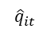
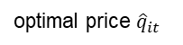
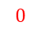
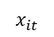
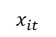

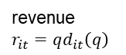
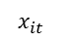
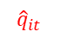
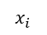
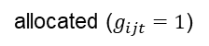
$$b_{it}$$
$$g_{it}$$
$$b_{1it}$$
$${\hat{q}}_{it}$$
✓1
pruned ($g_{ijt}=0$)
allocated ($g_{ijt}=1$)
$$x_{it}$$
$$b_{2it}$$
$$x_{i}$$
$${\hat{q}}_{it}$$
✓1
$$b_{3it}$$
$${\hat{q}}_{it}$$
$$q$$
✘0
1. bidding
2. asking and allocation
revenue
$r_{it}=qd_{it}\left(q\right)$
demand, revenue
$${\hat{q}}_{it}$$
$$−{\hat{q}}_{it}$$
$$x_{it}$$
demand $d_{it}(q)$
$$x_{it}$$
$${\hat{q}}_{it}$$
$$−{\hat{q}}_{it}$$
$$x_{it}$$
$$x_{it}$$
$$0$$
×
optimal price ${\hat{q}}_{it}$
price $q$
$$0$$
$${\overline{x}}_{i}$$
3. payment
4. shipment

Slide 7
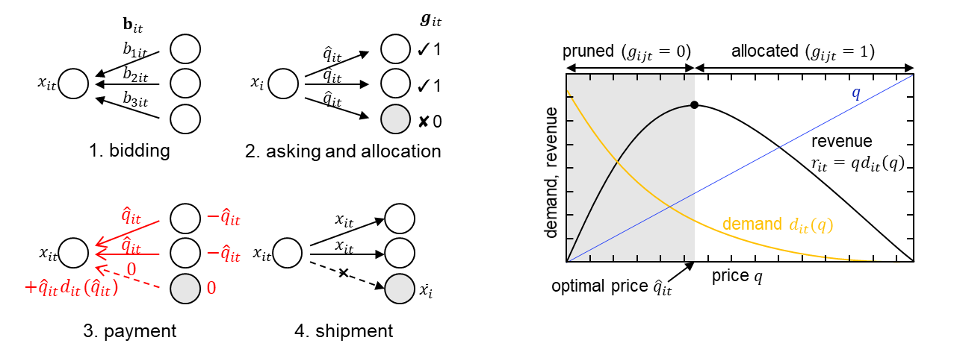

Slide 8
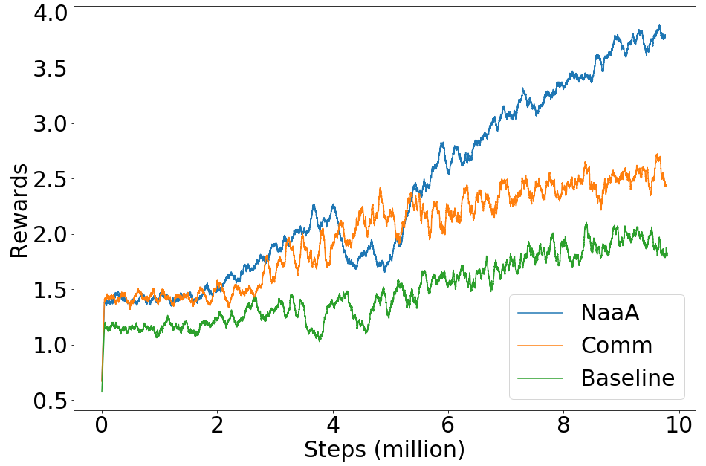
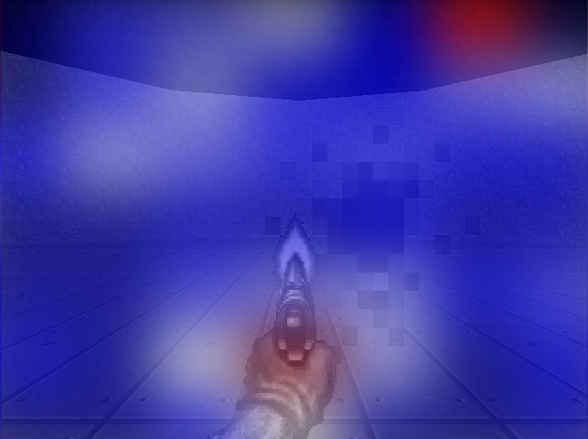
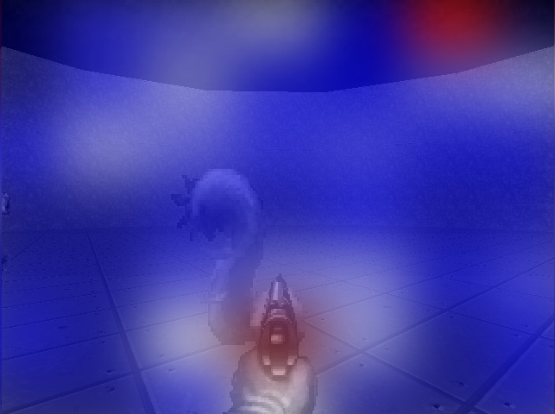
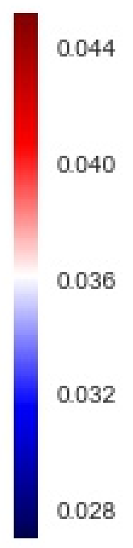
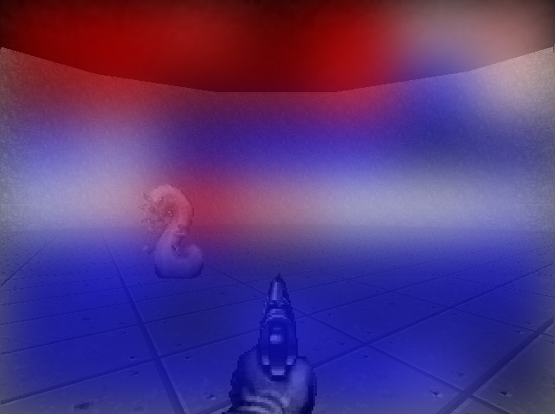
a
b

Slide 11
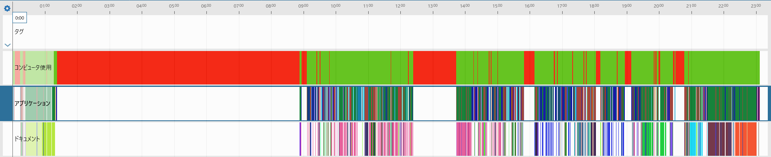






Slide 12

$$b_{it}$$
$$g_{it}$$
$$b_{1it}$$
$${\hat{q}}_{it}$$
✓1
pruned ($g_{ijt}=0$)
allocated ($g_{ijt}=1$)
$$x_{it}$$
$$b_{2it}$$
$$x_{i}$$
$${\hat{q}}_{it}$$
✓1
$$b_{3it}$$
$${\hat{q}}_{it}$$
$$q$$
✘0
1. bidding
2. asking and allocation
revenue
$r_{it}=qd_{it}\left(q\right)$
demand, revenue
$${\hat{q}}_{it}$$
$$−{\hat{q}}_{it}$$
$$x_{it}$$
demand $d_{it}(q)$
$$x_{it}$$
$${\hat{q}}_{it}$$
$$−{\hat{q}}_{it}$$
$$x_{it}$$
$$x_{it}$$
$$0$$
×
optimal price ${\hat{q}}_{it}$
price $q$
$+{\hat{q}}_{it}d_{it}({\hat{q}}_{it}$)
$$0$$
$${\overline{x}}_{i}$$
3. payment
4. shipment

Slide 13










Agent
Agent
$$s_{t},r_{t}$$
$$a_{t}$$
$$s_{t}$$
$$s_{t},r_{t}$$
$$a_{t}$$
Environment
Environment
Environment
$$s_{t}^{1}$$
$$s_{t}^{2}$$
$$a_{t}$$
$$s_{t}^{3}$$
$$s_{t}$$
$$a_{t}$$
Environment
$$R_{t}$$
Environment

Slide 14













$$s_{t}^{ex}$$
External Environment
$$a_{t}^{ex}$$
Internal Environment
Swarm
Internal Environment
State
$$ρ_{t}^{1}$$
$$R_{t}^{ex}$$
$$s_{t}$$
Action
$$ρ_{t}^{2}$$
$$a_{t}$$
$$v_{i}$$
$$R_{t}^{ex}$$
Reward
$$x_{jt}$$
Action
$$ρ_{t}^{3}$$
$$v_{j}$$
$$ρ_{ijt}$$
Reward
External Environment
External Environment
$$a_{t}$$
State
Action
Internal Environment
$$s_{t}$$
$$a_{t}$$
$$R_{t}^{ex}$$
$$R_{it}$$
$$R_{t}^{ex}$$
$$v_{i}$$
Reward
$$x_{jt}$$
$$v_{j}$$
$$ρ_{ijt}$$
External Environment

Slide 15



$$s_{t}$$
Environment
$$a_{t}$$
$$s_{t}^{ex}$$
External Environment
$$a_{t}^{ex}$$
Swarm
Internal Environment
$$R_{t}^{}$$
$$R_{t}^{ex}$$
Agent
$$v_{i}$$
$$x_{jt}$$
Action
$$v_{j}$$
$$ρ_{ijt}$$
Reward
$$s_{t}$$
Environment
$$a_{t}$$
External Environment
$$a_{t}^{ex}$$
Agent
Internal Environment
$$R_{t}$$
$$R_{t}^{ex}$$
$$v_{i}$$
$$v_{i}$$
$$x_{jt}$$
$$x_{jt}$$
$$ρ_{ijt}$$
$$v_{j}$$
$$ρ_{ijt}$$
$$v_{j}$$

Slide 16









$$s_{t}^{ex}$$
External Environment
$$a_{t}^{ex}$$
Swarm
Internal Environment
$$R_{t}^{ex}$$
$$v_{i}$$
$$x_{jt}$$
Action
$$v_{j}$$
$$ρ_{ijt}$$
Reward
$$s_{t}$$
Environment
$$a_{t}$$
$$s_{t}$$
Environment
$$a_{t}$$
External Environment
$$a_{t}^{ex}$$
Agent
Internal Environment
$$v_{k}$$
$$R_{t}^{}$$
$$R_{t}$$
$$R_{t}^{ex}$$
Agent
$$v_{k}$$
$$v_{i}$$
$$v_{i}$$
$$x_{jt}$$
$$x_{jt}$$
$$v_{j}$$
$$ρ_{ijt}$$
$$ρ_{ijt}$$
$$v_{j}$$

Slide 17













$$s_{t}^{ex}$$
External Environment
$$a_{t}^{ex}$$
Swarm
Internal Environment
$$R_{t}^{ex}$$
$$v_{i}$$
$$x_{jt}$$
Action
$$v_{j}$$
$$ρ_{ijt}$$
Reward
External Environment
$N_{i}^{in}$
$N_{i}^{out}$
$$s_{t}$$
Environment
$$a_{t}$$
$$a_{t}^{ex}$$
$$s_{t}$$
$$a_{t}$$
Agent
Internal
Environment
Environment
$$v_{i}$$
$$R_{t}^{}$$
$$R_{t}$$
$$R_{t}^{ex}$$
2
1
(d)
Agent
$$v_{i}$$
$$v_{i}$$
$$ρ_{ijt}$$
$$x_{jt}$$
$$ρ_{ijt}$$
$$v_{j}$$
$$v_{j}$$
$$v_{i}$$
$$c_{it}$$
$$r_{it}$$
(a)
(b)
(c)
(e)

Slide 18












$$s_{t}$$
Environment
$$a_{t}$$
External Environment
$$a_{t}^{ex}$$
$$s_{t}$$
$$a_{t}$$
Agent
Internal
Environment
$N_{i}^{in}$
$N_{i}^{out}$
Environment
$$a_{t}^{ex}$$
$$R_{t}^{}$$
$$R_{t}$$
$$R_{t}^{ex}$$
2
1
$$v_{i}$$
$$R_{t}^{ex}$$
Agent
$$v_{i}$$
$$v_{i}$$
$$x_{jt}$$
$$x_{it}$$
$$ρ_{ijt}$$
$$x_{jt}$$
$$c_{it}$$
$$v_{i}$$
$$r_{it}$$
$$v_{j}$$
$$v_{j}$$
$$ρ_{ijt}$$
(e)
(d)
(a)
(b)
(c)
Environment

Slide 19
Neuron as an Agent
$$s_{t}$$
Environment
$$a_{t}$$
External Environment
$$a_{t}^{ex}$$
$$s_{t}$$
$$a_{t}$$
Agent
Internal
Environment
$N_{i}^{in}$
$N_{i}^{out}$
Environment
$$a_{t}^{ex}$$
$$R_{t}^{}$$
$$R_{t}^{}$$
$$R_{t}^{ex}$$
2
2
1
1
$$v_{i}$$
$$R_{t}^{ex}$$
Agent
$$v_{i}$$
$$v_{i}$$
$$x_{jt}$$
$$x_{it}$$
$$ρ_{ijt}$$
$$x_{jt}$$
$$c_{it}$$
$$v_{i}$$
$$r_{it}$$
$$v_{j}$$
$$v_{j}$$
$$ρ_{ijt}$$
(a)
(b)
(c)
(d)
(e)
Environment
Environment
Agent
Agent
Agent
Agent

Slide 20






$$s_{t}$$
Environment
$$a_{t}$$
$$s_{t}$$
$$a_{t}$$
Agent
Environment
$$R_{t}^{}$$
$$R_{t}^{}$$
2
1
Agent
$$v_{i}$$
$$v_{j}$$
$$ρ_{ijt}$$
(a)
(b)
External Environment
$$a_{t}^{ex}$$
Internal
Environment
$N_{i}^{in}$
$N_{i}^{out}$
$$a_{t}^{ex}$$
$$R_{t}^{ex}$$
2
$$R_{t}^{ex}$$
1
$$v_{i}$$
$$v_{i}$$
$$x_{jt}$$
$$v_{i}$$
$$x_{it}$$
$$x_{jt}$$
$$ρ_{ijt}$$
$$c_{it}$$
$$r_{it}$$
$$v_{j}$$
(c)
(d)
(e)

Slide 21






















Environment
Environment
$$r$$
Trusted Third Party
$$r$$
$$s_{1}$$
$$a_{2}$$
$$s_{1}$$
$$a_{2}$$
$$r_{1}$$
$$r_{2 }$$
$$x_{12}$$
$$x_{12}$$
Agent 1
Agent 2
Agent 1
Agent 2
$$r_{1}$$
$$r_{2}=r−r_{1}$$
Environment
Environment
$$R$$
Trusted Third Party
$$s_{1}$$
$$a_{1}$$
$$r_{1}$$
$$s_{2}$$
$$a_{2}$$
$$r_{2}$$
$$s_{1}$$
$$a_{2}$$
$$R_{1}$$
$$R_{2 }$$
$$x_{12}$$
$$x_{12}$$
Agent 1
Agent 2
Agent 1
$$ρ_{21}$$
Agent 2
$$R_{1}=r_{1}+ρ_{21}$$
$$R_{2}=r_{2}−ρ_{21}$$

Slide 22






Environment
Environment
$$r$$
Trusted Third Party
$$r$$
$$s_{1}$$
$$a_{2}$$
$$s_{1}$$
$$a_{2}$$
$$r_{1}$$
$$r_{2 }$$
$$x_{12}$$
$$x_{12}$$
Agent 1
Agent 2
Agent 1
Agent 2
$$r_{1}$$
$$r_{2}=r−r_{1}$$
Environment
Environment
$$R$$
Trusted Third Party
$$R$$
$$R_{1}$$
$$R_{2 }$$
Agent 1
$$x_{12}$$
Agent 2
$$x_{12}$$
Agent 1
$$R_{1}$$
Agent 2
(a)
(b)
$$R_{2}=R−R_{1}$$

Slide 23






Environment
Environment
$$r$$
Trusted Third Party
$$r$$
$$s_{1}$$
$$a_{2}$$
$$s_{1}$$
$$a_{2}$$
$$r_{1}$$
$$r_{2 }$$
$$x_{12}$$
$$x_{12}$$
Agent 1
Agent 2
Agent 1
Agent 2
$$r_{1}$$
$$r_{2}=r−r_{1}$$
Environment
Environment
$$R$$
Trusted Third Party
$$R$$
$$R_{1}$$
$$R_{2 }$$
$$x_{12}$$
$$x_{12}$$
Agent 1
Agent 2
Agent 1
$$R_{1}$$
Agent 2
$$R_{2}=R−R$$
(a)
(b)

Slide 24






Environment
Environment
$$r$$
Trusted Third Party
$$r$$
$$s_{1}$$
$$a_{2}$$
$$s_{1}$$
$$a_{2}$$
$$r_{1}$$
$$r_{2 }$$
$$x_{12}$$
$$x_{12}$$
Agent 1
Agent 2
Agent 1
Agent 2
$$r_{1}$$
$$r_{2}=r−r_{1}$$
Environment
Environment
Environment
$$R$$
Trusted Third Party
$$R$$
$$R$$
$$R_{1}$$
$$R_{2 }$$
$$R_{2}=R−R_{1}$$
$$x_{12}$$
$$x_{12}$$
$$x_{12}$$
Agent 1
Agent 2
Agent 1
$$R_{1}$$
Agent 2
Agent 1
$$R_{1}$$
Agent 2
(a)
(b)
$$R_{2}=R−R$$
(b)

Slide 25







Environment
Environment
$$r$$
Trusted Third Party
$$r$$
$$s_{1}$$
$$a_{2}$$
$$s_{1}$$
$$a_{2}$$
$$r_{1}$$
$$r_{2 }$$
$$x_{12}$$
$$x_{12}$$
Agent 1
Agent 2
Agent 1
Agent 2
$$r_{1}$$
$$r_{2}=r−r_{1}$$
$$s_{t}$$
$$a_{t}$$
Environment
Environment
Environment
$$R$$
Agent
Trusted Third Party
$$R$$
$$R_{t}^{ex}$$
$$R_{1}$$
$$R_{2 }$$
$$R_{2}=R−R_{1}$$
$$x_{12}$$
$$x_{12}$$
$$v_{i}$$
Agent 1
Agent 2
Agent 1
$$R_{1}$$
Agent 2
$$v_{j}$$
$$ρ_{ijt}$$
(a)
(b)
(b)

Slide 26








Environment
Environment
$$r$$
Trusted Third Party
$$r$$
$$s_{1}$$
$$a_{2}$$
$$s_{1}$$
$$a_{2}$$
$$r_{1}$$
$$r_{2 }$$
$$x_{12}$$
$$x_{12}$$
Agent 1
Agent 2
Agent 1
Agent 2
$$r_{1}$$
$$r_{2}=r−r_{1}$$
Environment
Environment
$$s$$
$$a$$
Environment
$$R$$
$$Q(s,a)$$
Trusted Third Party
$$R$$
$$R$$
$$R_{1}$$
$$R_{2 }$$
$$R_{2}=R−R_{1}$$
$$v_{i}$$
$$x_{12}$$
$$x_{12}$$
$$v_{j}$$
$$ρ_{ij}$$
Agent 1
Agent 2
Agent 1
$$R_{1}$$
Agent 2
(a)
(b)
(c)

Slide 27
Environment
Environment
observation
sellers
buyers
Trusted Third Party
reward
4.91
✔
buyer 1
4.20
4.20
agent 1
agent 2
seller
✔
buyer 2
✖
0.01
✖
buyer 3

Slide 28
Environment
Environment
representation
sellers
buyers
Trusted Third Party
reward
4.91
✔
buyer 1
4.20
4.20
agent 1
agent 2
seller
✔
buyer 2
✖
0.01
✖
buyer 3

Slide 29





Environment
Environment
$$R$$
$$s_{2}$$
Trusted Third Party
$$R$$
$$R_{1}$$
$$R_{2 }$$
$$R_{2}=R−R_{1}$$
$$a_{1}$$
$$a_{2}$$
$$x_{1}$$
Agent 1
$$x_{1}$$
Agent 2
Agent 1
Agent 2
$$R_{1}$$
(a)
(b)

